Slide 1
Schuyler
County
Industrial Development Agency
PILOT & SUBLEASE
SUMMARY
AUGUST 2026
(2026 PILOT & Lease Payments)
- Actual -
To be distributed to all Affected Tax Jurisdictions in Schuyler County.

Slide 2
How to use this report
PILOT payments help local governments offset losses in property taxes due the existence of nontaxable lands within their boundaries.
This report is to be used to help determine the dollar amount of tax income each municipality will receive for Tax Roll Section 8 – Exempt Properties listed under the Schuyler County Industrial Development Agency (SCIDA); commonly known as PILOT (Payment in Lieu of Taxes) Payments.
The property lease holder makes payments directly to the Schuyler County Industrial Development Agency. These payments are divided up among the Affected Taxing Jurisdictions and paid directly to each jurisdiction. Each PILOT has different payment agreement plans, but all payments are processed and paid in the same manner.
If you have any questions or would like more information on the PILOT process or PILOTs in your jurisdiction, please reach out to our office for clarification.
How to read this report
Each municipality should locate the properties within their jurisdiction.
The amount listed to be paid to your jurisdiction is the amount you will receive for the given calendar year.
The due date of each PILOT will reflect the timing in which you will receive payments (payments are passed through within 30 days of receipt).
Payments due in February are paid at the previous years rate and assessment value, due to timing of reevaluations.
Payments made May through December are paid at the current years rate and assessment value.
Reports dated February: February amounts listed will be paid exactly as listed. May – December amounts are estimated and may change due to any rate and assessment adjustments in March.
Reports Dated August: All amounts listed will be paid exactly as shown, except any PILOT or lease payments that are based on the previous year revenues. Those amounts will be listed as the actual previous year payment amount and will vary based on the actual revenues reported on the due date.
PILOT Termination
Each Affected Taxing Jurisdiction will be notified of the termination date within two years of termination.
This will allow sufficient time for each jurisdiction to return the terminated property back onto the regular tax rolls (Tax Roll Section 1) at the conclusion of the PILOT.
Solar Installations
Solar installations have a separate parcel number than the property they are installed on. This is usually identical to the actual property parcel number, with a /1. The PILOT payments are to cover the solar installation portion only. The actual parcel will still be billed to the property owner at full tax amounts due. Solar installations pay a base amount (the actual assessed value at the time the PILOT began) and an additional amount for the Mwac they will produce. The Mwac amount increases by 2% annually.
Leases
The listed lease payments are passthrough payments to the Schuyler County Treasurer ONLY.
The Schuyler County IDA is the leaseholder the Seneca Harbor Marina property, docks, and the Seneca Harbor Marina Restaurant.
When a tenant pays their annual lease payments, the payment is passed through to the County directly, less a 5% administration fee.
For questions on PILOTS, leases, or any other information provided in this report, please contact:
Schuyler County Industrial Development Agency
216 N. Franklin Street Watkins Glen, New York 14891
(607) 535-4341
admin@flxgateway.com
Actual Payment Amount – 2026

Slide 3
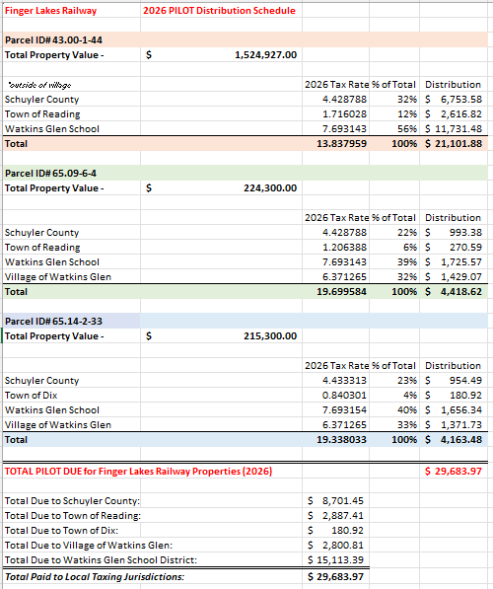
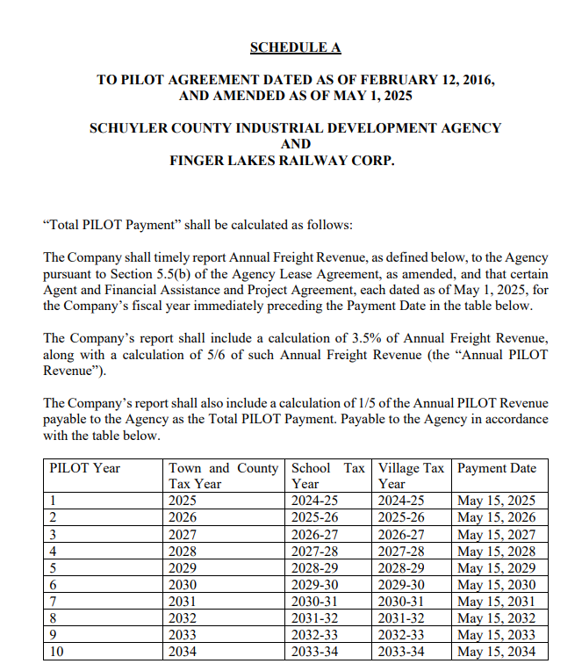
Finger Lakes Railway –
Due May 1
Parcel# 43.00-1-44 (Town of Reading, outside of Village)
Parcel# 65.09-6-4 (Town of Reading, inside of Village)
Parcel# 65.14-2-33 (Town of Dix, inside of Village)
NOTE – This payment is based on total revenues earned in 2025
Note: Finger Lakes Railway pays their PILOT based on a portion of their previous year revenue. As this amount is divided evenly between 5 counties. With limited trackage in our county, their payment equates to the full property tax liability.
Actual Payment Amount – 2026

Slide 4
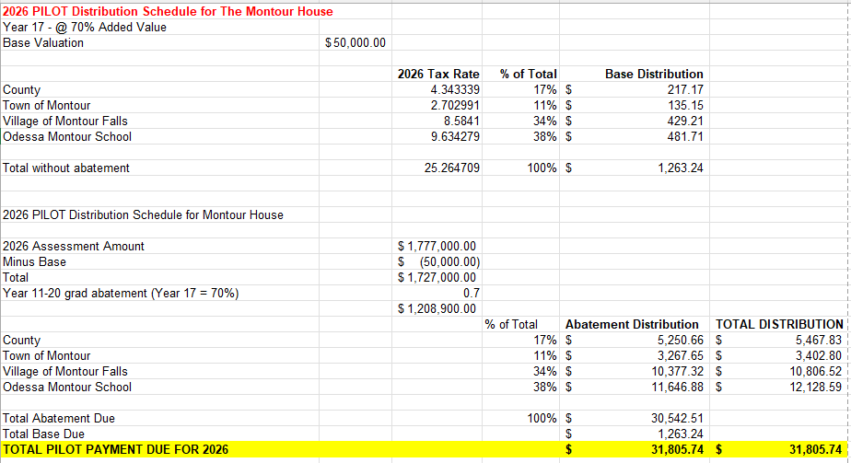
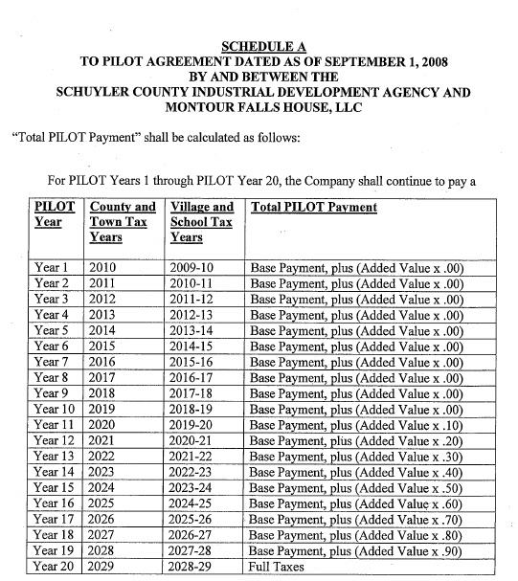
Montour Falls House, LLC
Due August 1
Parcel# 86.07-9-51
Note: This PILOT has been transferred to Capriotti Properties, LLC. as of 2025.
No changes to PILOT terms/straight transfer.
Actual Payment Amount – 2026

Slide 5
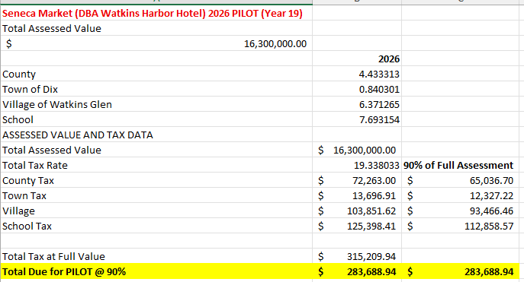
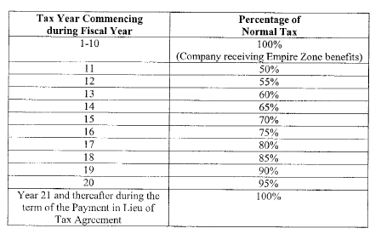
Seneca Market 1
(DBA Watkins Glen Harbor Hotel)
Due September 1
Parcel# 65.09-7-19
Actual Payment Amount – 2026

Slide 6
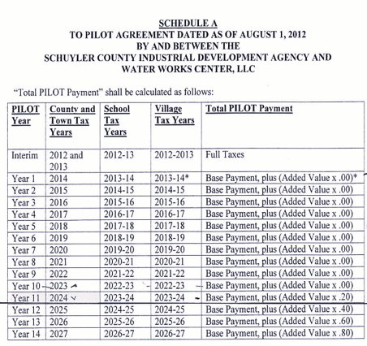
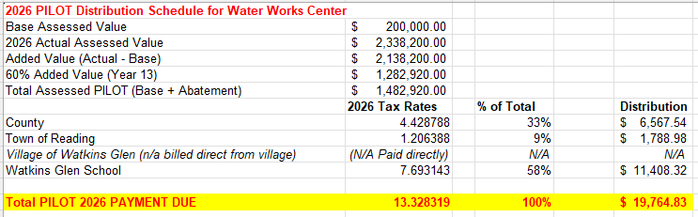
Water Works Center
Due September 1
Parcel# 64.08-4-12 & 64.08-4-13
Note: This PILOT has been transferred to Capriotti Properties, LLC. as of 2025.
No changes to PILOT terms/straight transfer.
Actual Payment Amount – 2026

Slide 7
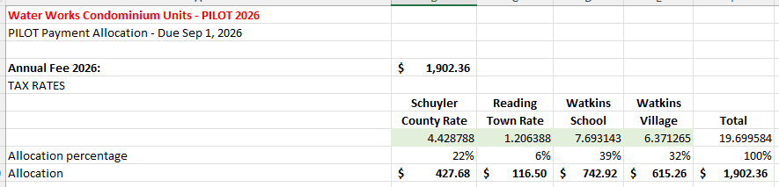
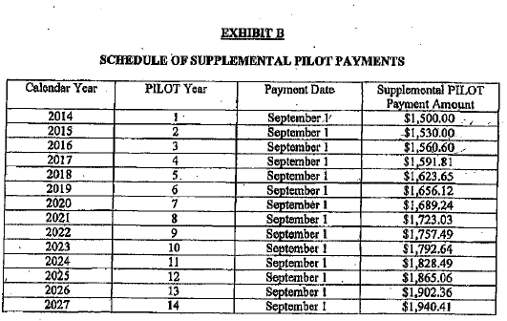
Water Works Center
Omnibus Condo Units
Due September 1
Unit 41 – Matus (Parcel# 64.08-4-14/1)
Unit 43 – Zentz (Parcel# 64.08-4-14/2)
Unit 45 – Roebal/Gibson (Parcel# 64.08-4-14/3)
Unit 47 – D’Amigo (Parcel# 64.08-4-14/4)
Unit 49 – Makoske (Parcel# 64.08-4-14/5)
Unit 51 – Elias (Parcel# 64.08-4-14/6)
Unit 53 – Nwaneri (Parcel# 64.08-4-14/7)
Unit 61- Riegner (Parcel# 64.08-4-14/11)
Note: The Water Works Omnibus Units have a predetermined payment amount.
Each unit will be billed the amount below for the given year.
SPECIAL NOTE: Unit 55 (Parcel# 64.08-4-14/8) was sold in 2026. This unit is now on Tax Roll 1 and should be billed direct to the new property owner.
Actual Payment Amount – 2026

Slide 8
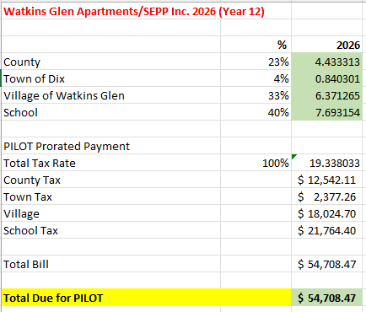
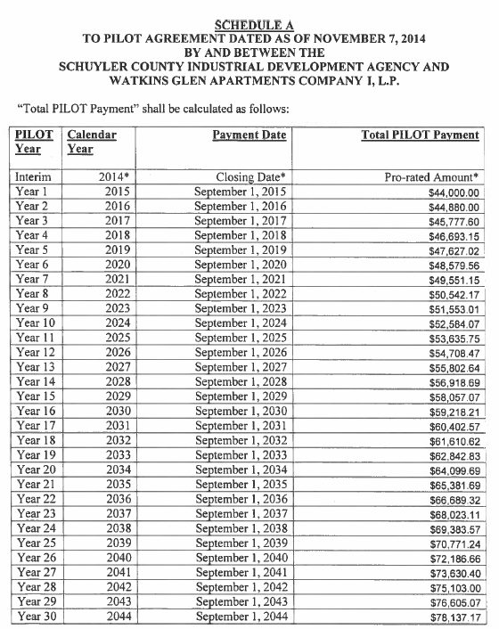
Watkins Glen Apartments/SEPP, Inc.
Due September 1
Parcel# 65.13-6-21
Note: Watkins Glen Apartments/SEPP Inc. has a predetermined payment amount. PILOT payments will be made at the amount as listed on the Schedule A.
Actual Payment Amount – 2026

Slide 9
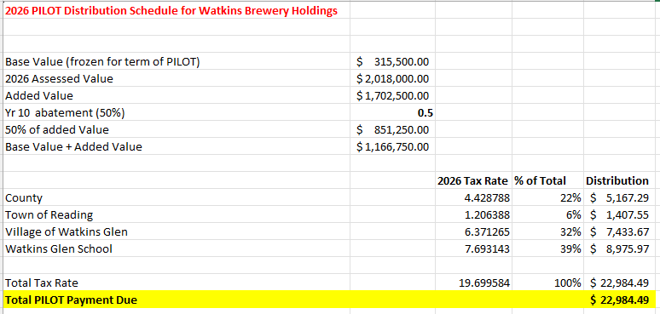
Watkins Brewery Holdings, LLC
Due September 1
Parcel# 65.09-6-19 & 65.09-6-20
Actual Payment Amount – 2026

Slide 10
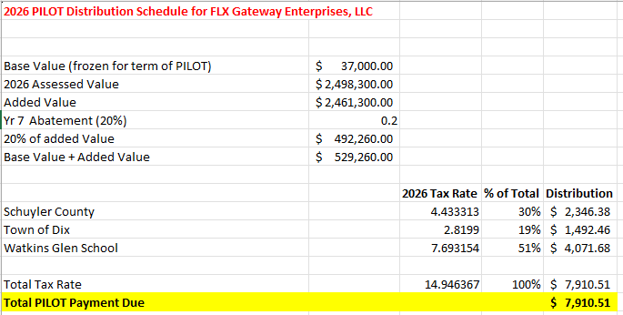
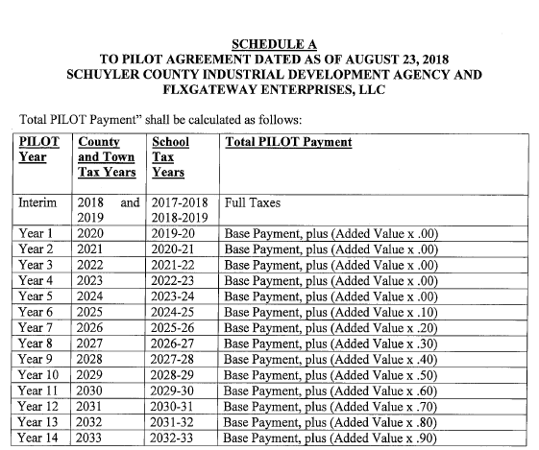
FLX Gateway Enterprises, LLC
Due September 1
Parcel# 85.00-1-26
Actual Payment Amount – 2026

Slide 11
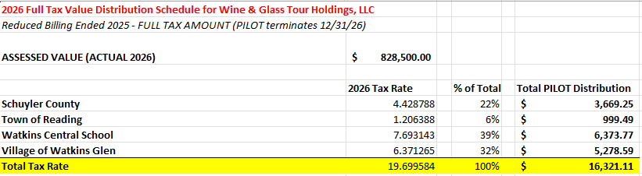
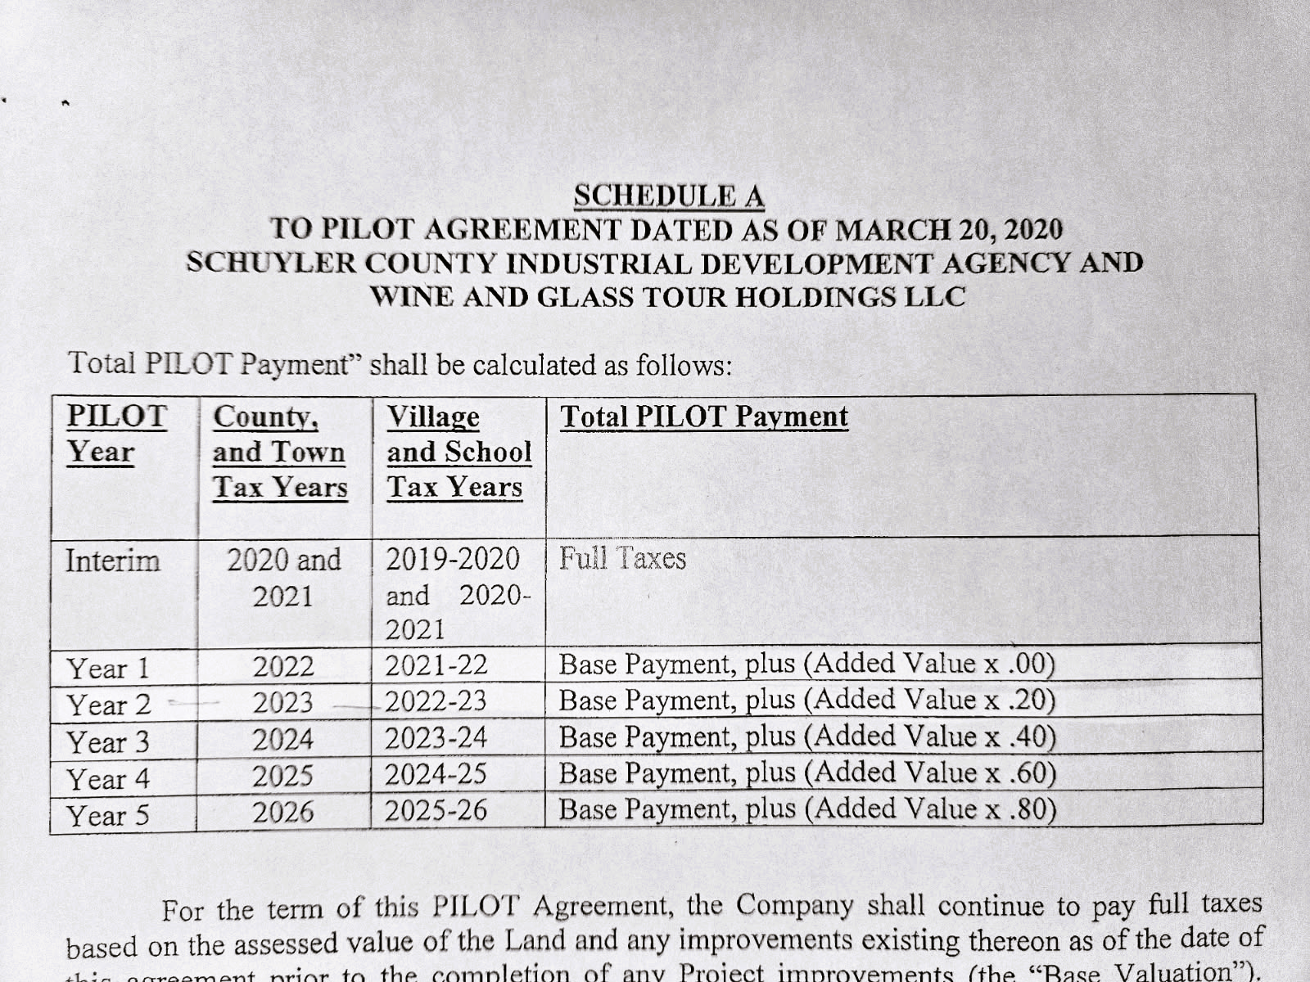
Wine & Glass Tour Holding, LLC
Due September 30
Parcel# 65.9-6-17
NOTE: Per billing cycle/customer, 2025 was the final reduced tax PILOT for Wine & Glass Tour Holdings.
The SCIDA will bill full (100%) taxes in September 2026.
PILOT terminates December 31, 2026.
Actual Payment Amount – 2026

Slide 12
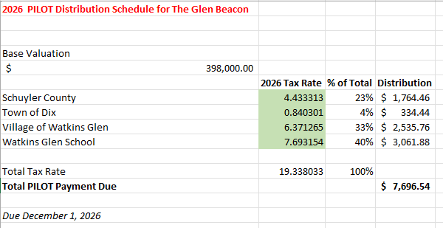
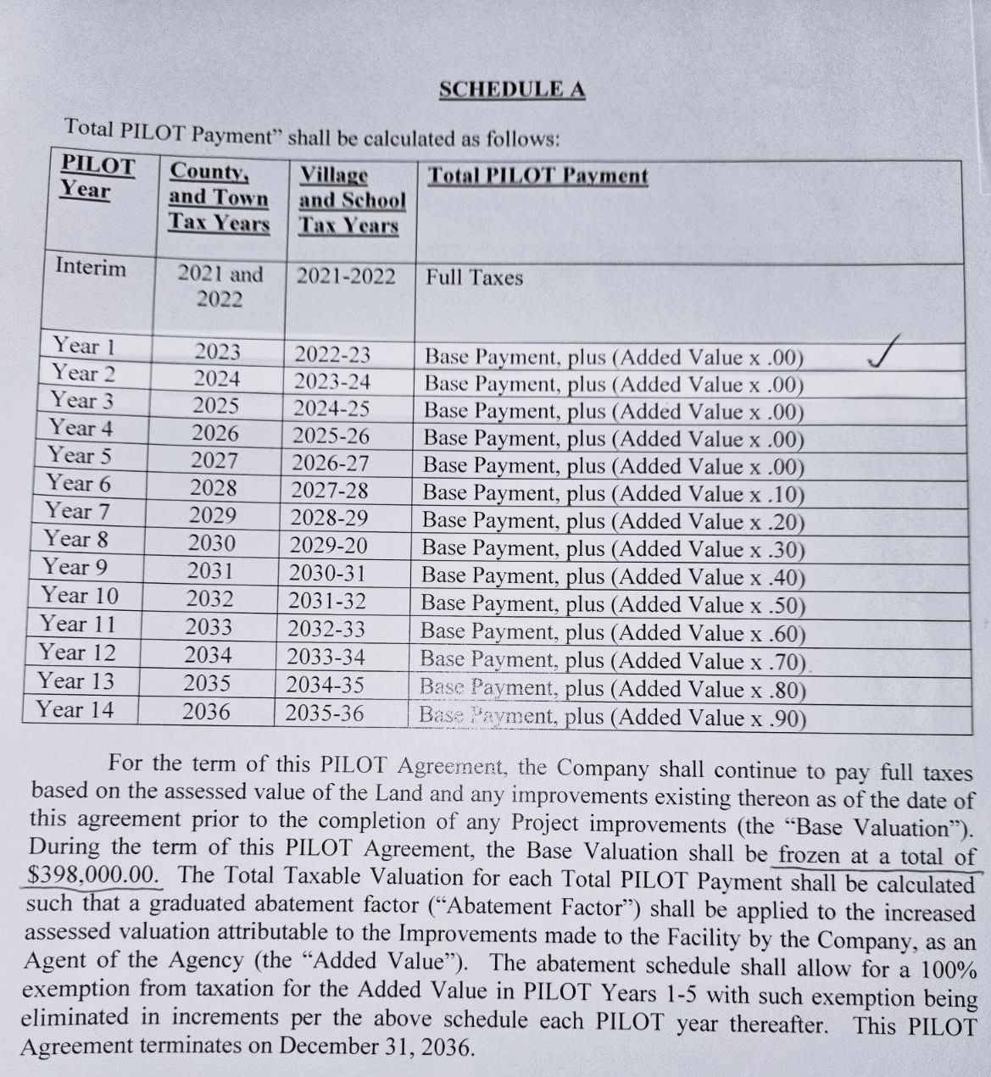
The Glen Beacon
Due December 31
Parcel# 65.45-1-11 & 65.45-1-12
Actual Payment Amount – 2026

Slide 13
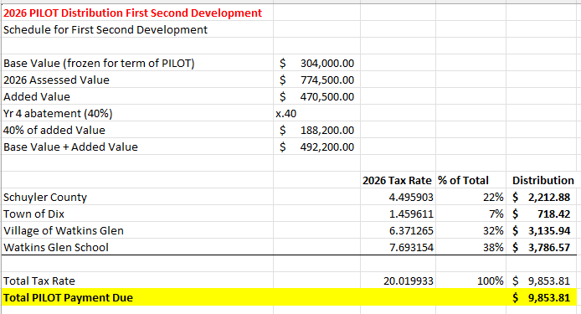
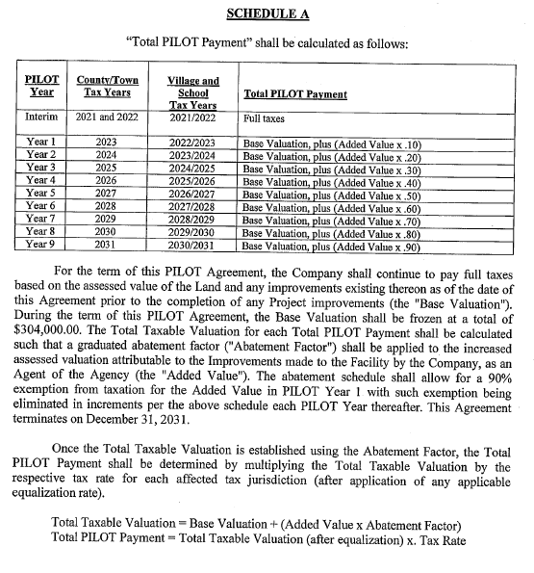
First Second Development
Due February 1
Parcel# 65.09-7-20
Actual Payment Amount – 2026

Slide 14
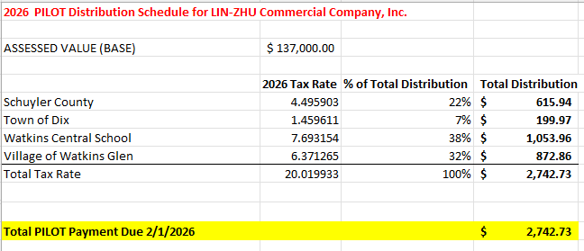
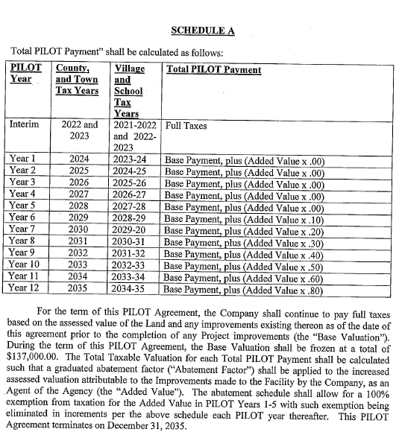
Lin-Zhu Commercial Company
Due February 1
Parcel# 65.17-6-19
Actual Payment Amount – 2026

Slide 15

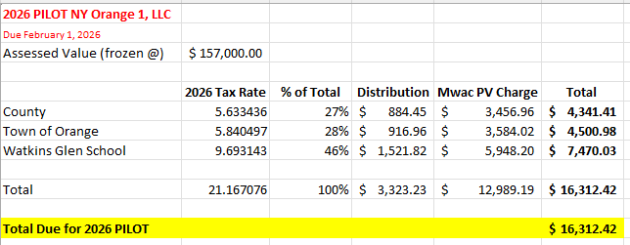
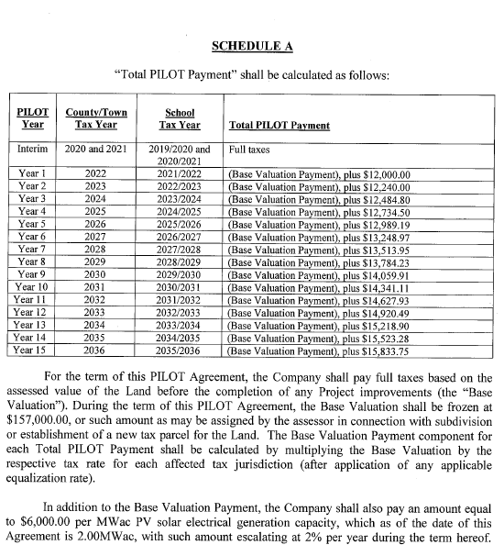
Solar Installation:
NY Orange 1, LLC
Due February 1
Parcel# 83.00-1-20/1
Actual Payment Amount – 2026

Slide 16
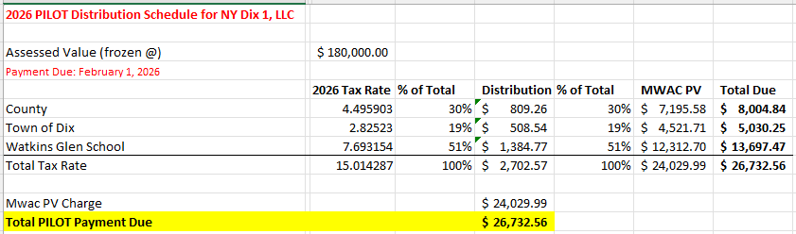
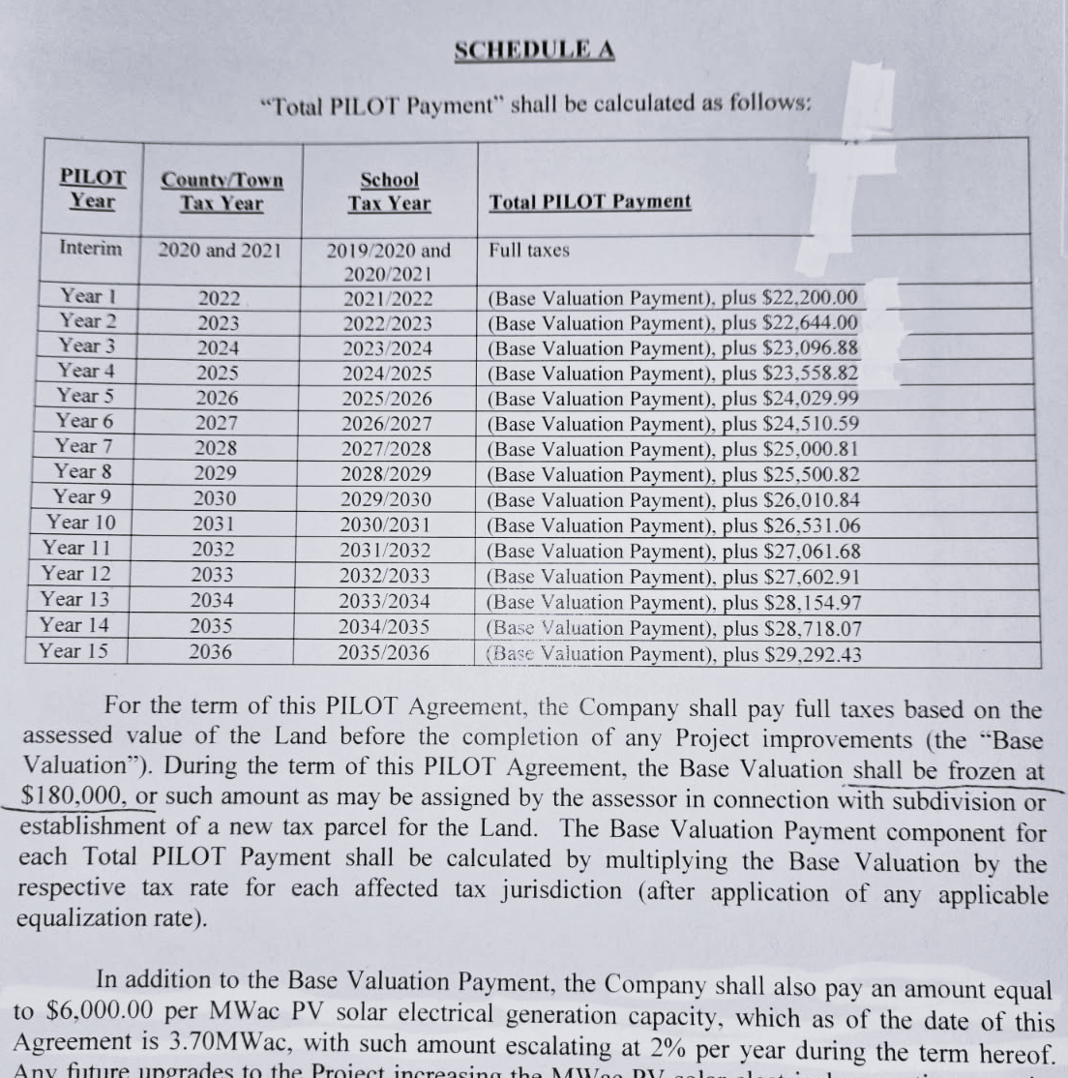
Solar Installation:
NY Dix 1, LLC
Due February 1
Parcel# 74.00-1-29.21/1
Actual Payment Amount – 2026

Slide 17
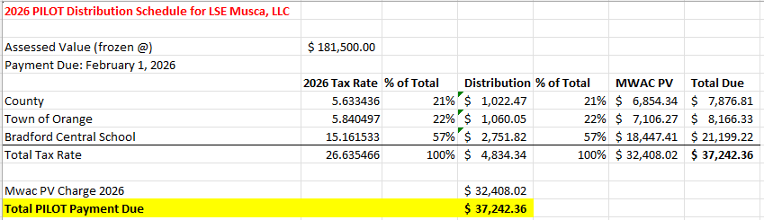
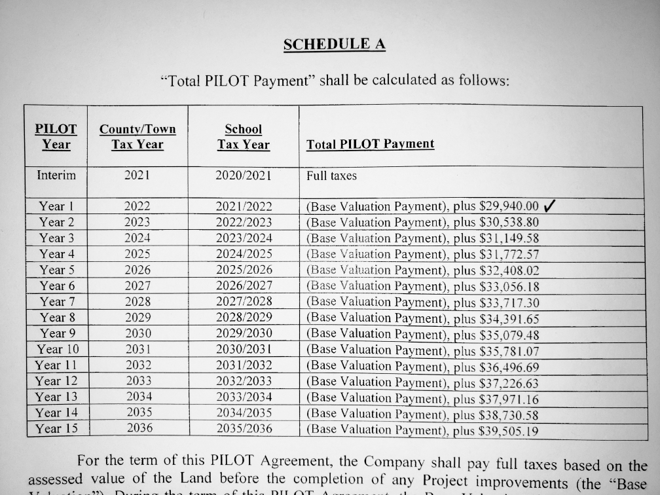
Solar Installation:
LSE MUSCA, LLC
Due February 1
Parcel# 92.00-2-37.1/1
Actual Payment Amount – 2026

Slide 18
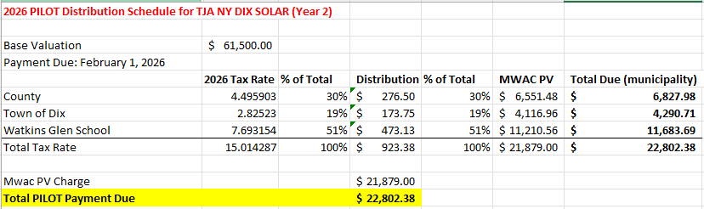
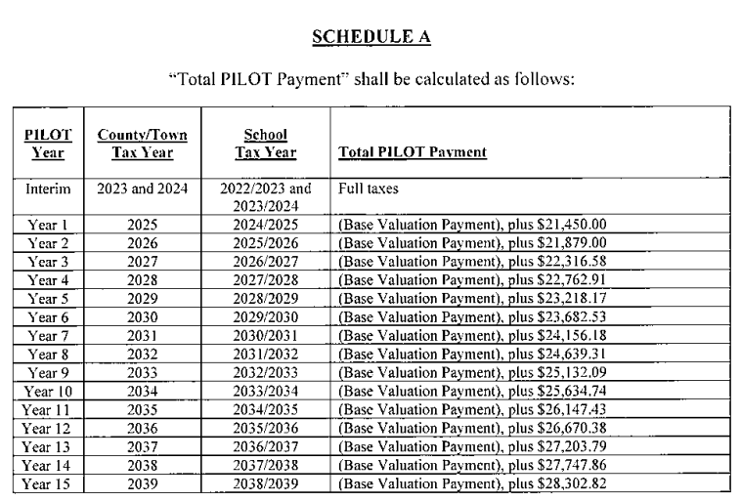
Solar Installation:
TJA NY DIX SOLAR
Due February 1
Parcel# 95.00-3-27/1
Actual Payment Amount – 2026

Slide 19
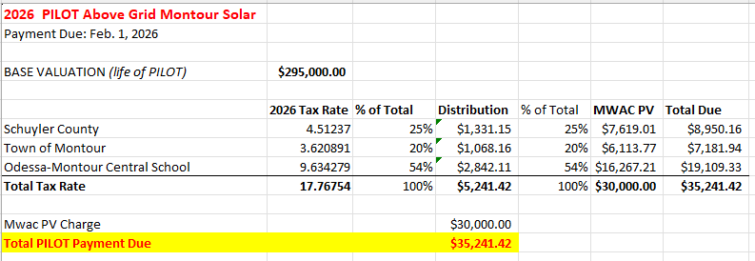
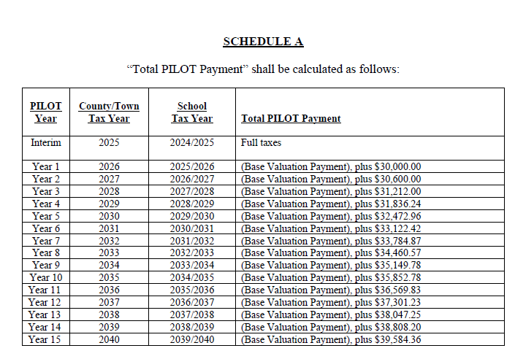
Solar Installation:
Above Grid Montour Solar
Due February 1
Actual Payment Amount – 2026

Slide 20
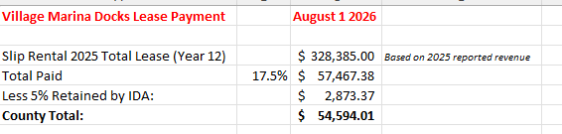
SUBLEASE (County Only):
Village Marina Docks
Due August 1
Note: This lease amount is based on the previous year revenue. If this report is distributed before the current year payment is made, the amount listed will be an estimated amount based on the previous year reporting. The payment amount may vary depending on the actual revenue reported for the previous year.
LEASE YEAR | RENTAL | LEASE YEAR* | RENTAL | LEASE YEAR * | RENTAL | LEASE YEAR * | RENTAL
1 – 2014 | 12.0% OF GROSS | 6 – 2019 | 14.5% OF GROSS | 11 – 2024 | 17. 0% OF GROSS | 16 – 2029 | 19.5% OF GROSS
2 – 2015 | 12.5% OF GROSS | 7 – 2020 | 15.0% OF GROSS | 12 - 2025 | 17.5% OF GROSS | 17 - 2030 | 20.0% OF GROSS
3 – 2016 | 13.0% OF GROSS | 8 – 2021 | 15.5% OF GROSS | 13 - 2026 | 18.0% OF GROSS | 18 - 2031 | 20.5% OF GROSS
4 - 2017 | 13.5% OF GROSS | 9 - 2022 | 16.0% 0F GROSS | 14 - 2027 | 18.5% OF GROSS | 19 - 2032 | 21.0% OF GROSS
5 – 2018* | 14.0% OF GROSS | 10 – 2023 | 16.5% OF GROSS | 15 – 2028 | 19.0% OF GROSS | 20 – 2033 | 21.5% OF GROSS
Amount listed is estimated for 2026 payment.
* - Lease Year and Rentals subject to timely and enforceable Option exercise by Agency.
** - Rental for Lease Year 20 (2032-2033) shall be due and payable on or before June 1, 2033.
Estimated Payment Amount – 2026

Slide 21
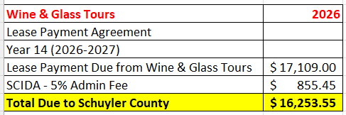
SUBLEASE (County Only):
Wine & Glass Tours
Due September 1
LEASE YEAR | REANTAL | LEASE YEAR * | RENTAL | LEASE YEAR * | RENTAL | LEASE YEAR * | RENTAL
1 – 2013/14 | 2.6(A) ABOVE | 6 – 2018/19 | $13,500 | 11 – 2023/24 | $15,888 | 16 – 2028/29 | $17,975
2 – 2014/15 | $10,000 | 7 – 2019/20 | $14,000 | 12 - 2024/25 | $16,285 | 17 – 2029/30 | $18,424
3 – 2015-16 | $12,000 | 8 – 2020/21 | $14,500 | 13 – 2025/26 | $16,692 | 18 – 2030/31 | $18,885
4 – 2016/17 | $12,500 | 9 – 2021/22 | $15,000 | 14 – 2026/27 | $17,109 | 19 – 2031/32 | $19,357
5 – 2017-18 | $13,000 | 10 – 2022/23 | $15,500 | 15 – 2027/28 | $17,537 | 20 – 2032/33 | $19,841**
Actual Payment Amount – 2026

Slide 22
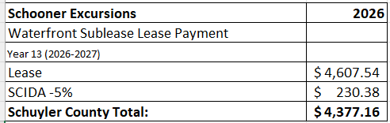
SUBLEASE (County Only):
Schooner Excursions
Due September 1
Lease Year | Rental | Lease Year* | Rental | Lease Year* | Rental | Lease Year* | Rental
1 2014-15 | 2.6(a) above | 6 2019-20 | $3,502.00 | 11 2024-25 | $4,179.18 | 16 2029-30 | $5,333.80
2 2015-16 | $2,800.00 | 7 2020-21 | $3,607.06 | 12 2025-26 | $4,388.13 | 17 2030-31 | $5,600.49
3 2016-17 | $3,000.00 | 8 2021-22 | $3,715.27 | 13 2026-27 | $4,607.54 | 18 2031-32 | $5,880.52
4 2017-18 | $3,200.00 | 9 2022-23 | $3,863.88 | 14 2027-28 | $4,837.92 | 19 2032-33 | **$6,174.55
5 2018-19 | $3,400.00 | 10 2023-24 | $4,018.44 | 15 2028-29 | $5,079.81
Actual Payment Amount – 2026

Slide 23
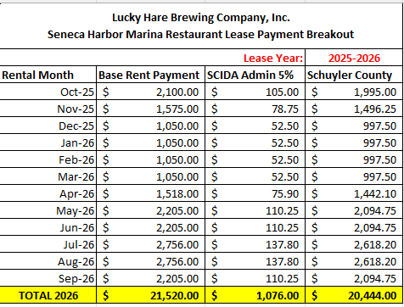
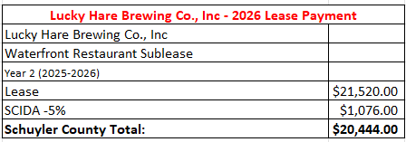
SUBLEASE (County Only):
Lucky Hare Brewing Co. (Seneca Harbor Marina Restaurant)
Due September 1
*Additional payment MAY BE added, based on gross income generated on the property that exceeds $400,000.
This amount is TBD and supported with financial records.
Actual Payment Amount – 2026

Slide 24
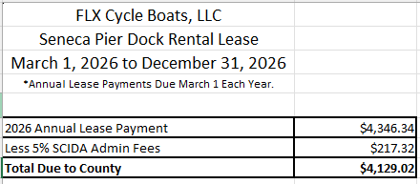
SUBLEASE (County Only):
FLX Cycle Boats
Due March 1
Actual Payment Amount – 2026

Slide 25
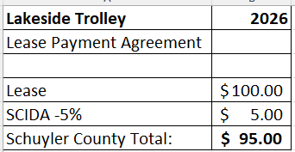
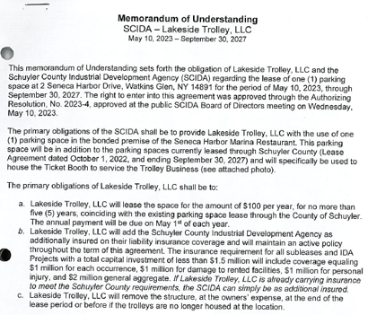
SUBLEASE (County Only):
Lakeside Trolley
Due May 1
Actual Payment Amount – 2026

Slide 26
Upcoming Termination of PILOTs & Leases
Wine & Glass Tour Holdings – PILOT Terminates December 31, 2026
Seneca Market 1 (dba Watkins Glen Harbor Hotel) – PILOT Terminates Dec. 31, 2027
All remaining Water Works Omnibus Units – PILOTs Terminate Dec. 31, 2027
SPECIAL NOTE: Water Works Unit 55 (Parcel# 64.08-4-14/8) was sold in 2026. This unit is now on Tax Roll 1 and should be billed direct to the new property owner.

Slide 27
PILOT & Lease Due Dates
(Payments to jurisdictions are paid within 30 days of receipt of payment)
SOLAR PILOTS
LSE MUSCA – Due February 1
NY DIX 1 – Due February 1
NY ORANGE – Due February 1
TJA NY DIX Solar – Due February 1
Above Grid Montour Solar – Due February 1
PILOT DUE DATES
Lin Zhu – Due February 1
First Second Development – Due February 1
Finger Lakes Rail – Due May 1
Montour House – Due August 1
Water Works Center – Due September 1
Omnibus WWC – Due September 1
Seneca Market I dba Watkins Harbor Hotel - Due September 1
Watkins Brewery Holdings – Due September 1
SEPP – Watkins Apartments – Due September 1
FLX Gateway Enterprises LLC – Due September 1
The Glen Beacon – Due December 31
LEASE DUE DATES
Marina Docks Lease – Due August 1
Wine & Glass Tours Lease – Due September 1
Schooner Excursions Lease – Due September 1
FLX Cycle Boats, LLC – Due March 1
Lakeside Trolley – Due May 1
Lucky Hare Brewing Company, Inc. – Paid monthly/Disbursed September 1
END OF REPORT

